Slide 1


JAVA Java Interview boot camp Core concepts
Lecture 20
CHAPTER 21
Nested/Inner Classes

Slide 2
Modifiers Applied To Local Inner Class
The same rules which apply to modifiers about local variables also apply to method-local inner classes
We can’t, mark a method-local inner class as public, private, protected, static and transient, and the like.
For the purpose of the interview, the only modifiers we can apply to a method-local inner class are abstract and final

Slide 3
Anonymous Inner Class
An anonymous inner class is the same as a local inner class with one difference: it does not have a name.
Since it does not have a name, it cannot have a constructor.
So then how we can create objects of an anonymous class if it does not have a constructor ?

Slide 4
Anonymous Inner Class
An anonymous class is a one-time class.
We define an anonymous class and create its object at the same time.
We cannot create more than one object of an anonymous class.

Slide 5
Anonymous Inner Class
Since anonymous class declaration and its object creation are interlaced, an anonymous class is always created using the new operator as part of an expression.
The general syntax for creating an anonymous class and its object is as follows:
new <interface-name or class-name> (<argument-list>) { // Anonymous class body goes here }

Slide 6
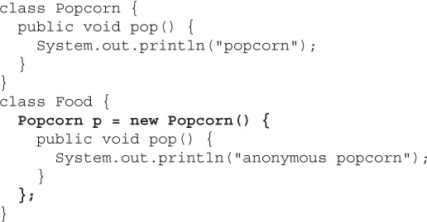
Anonymous Inner Class
This is where the anonymous class is starting
This is where the anonymous class is ending

Slide 7
Analysis Of The Code
We define two classes: Popcorn and Food.
Popcorn has one method: pop().
Food has one instance variable, declared as type Popcorn.
Food has no methods.

Slide 8
Analysis Of The Code
Now the most important thing :
Can you tell to whom p is referring ?
The Popcorn reference variable p refers not to an instance of Popcorn, but to an instance of an anonymous (unnamed) subclass of Popcorn.

Slide 9
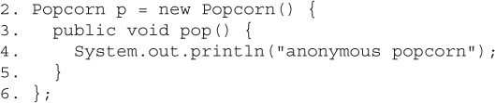
Analysis Of The Code
Declare a reference variable , p , of type Popcorn. Then declare a class that has no name but that is a subclass of Popcorn and here is the curly brace that opens class body
Look at the code again: How is line 2 read ?

Slide 10
Analysis Of The Code
Line 3 is the first statement within the new class and is actually overriding the pop() method of the superclass Popcorn. This is the whole point of making an anonymous inner class—to override one or more methods of the superclass!(or to implement methods of an interface)
Look at the code again: How is line 3 read ?

Slide 11
Analysis Of The Code
Line 4 is the first (and in this case only) statement within the overriding pop() method. Nothing special there.
Look at the code again: How is line 4 read ?

Slide 12
Analysis Of The Code
Look at the code again: How is line 5 read ?
Line 5 is the closing curly brace of the pop() method. Again Nothing special.

Slide 13
Analysis Of The Code
Look at the code again: How is line 6 read ?
Line 6 includes a curly brace closing off the anonymous class definition. But it also has the semicolon that ends the statement started on line 2—the statement where it all began—the statement declaring and initializing the Popcorn reference variable. And what you’re left with is a Popcorn reference to a brand-new instance of a brand-new, just-in-time, anonymous (no name)subclass of Popcorn.

Slide 14
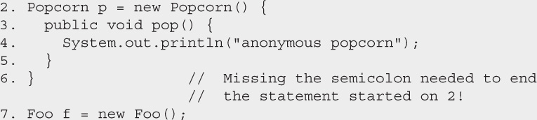
Caution!!! Be Careful!
The closing semicolon is hard to spot. Watch for code like this: You’ll need to be especially careful about the syntax when inner classes are involved, because the code on line 6 looks perfectly natural. It’s rare to see semicolons following curly braces.

Slide 15
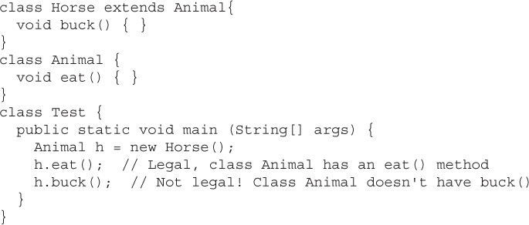
Another Point To Remember!!!
Rules of Polymorphism are in action when anonymous inner classes are involved.
We can only call methods on an anonymous inner class object that are defined in the reference variable type

Slide 16
Another Point To Remember!!!
So in the interview, we must be able to spot an anonymous inner class that—rather than overriding a method of the superclass—defines its own new method.
The method definition isn’t the problem, though; the real issue is, how do you invoke that new method?

Slide 17
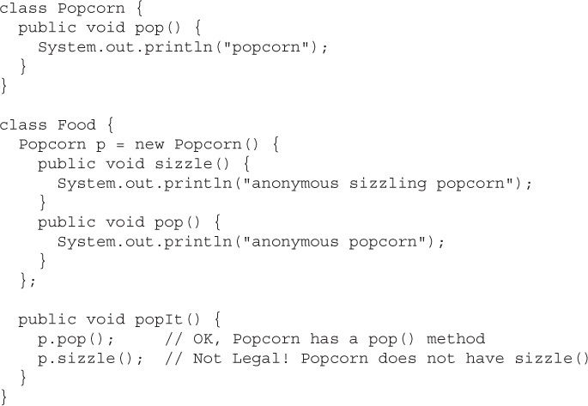
Another Point To Remember!!!

Slide 18
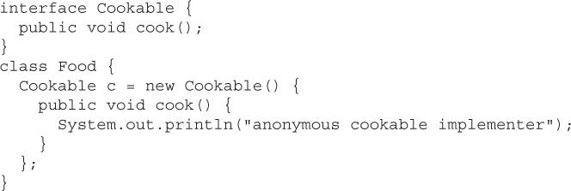
Second Way Of Writing Anonymous Class
We can also create an anonymous implementer of the specified interface type

Slide 19
Second Way Of Writing Anonymous Class
The code below , like the Popcorn example, still creates an instance of an anonymous inner class, but this time, the new just-in-time class is an implementer of the Cookable interface.
Also note that this is the only time you will ever see the syntax:
new Cookable()

Slide 20
Second Way Of Writing Anonymous Class
So how do we read the statement
Cookable c = new Cookable() {
“Declare a reference variable of type Cookable that, obviously, will refer to an object from a class that implements the Cookable interface”.

Slide 21
Point To Remember!!!
One more thing to keep in mind about anonymous interface implementers—they can implement only one interface.
There simply isn’t any mechanism to say that our anonymous inner class is going to implement multiple interfaces.

Slide 22
Point To Remember!!!
In fact, an anonymous inner class can’t even extend a class and implement an interface at the same time.
The inner class has to choose either to be a subclass of a named class—and not directly implement any interfaces at all—or to implement a single interface.

Slide 23
Caution!!! Be Careful!
The following is not legal:
whereas the following is legal, because it’s instantiating an implementer of the Runnable interface (an anonymous implementation class):

